Slide 1
Chap#7
File Systems

Slide 2
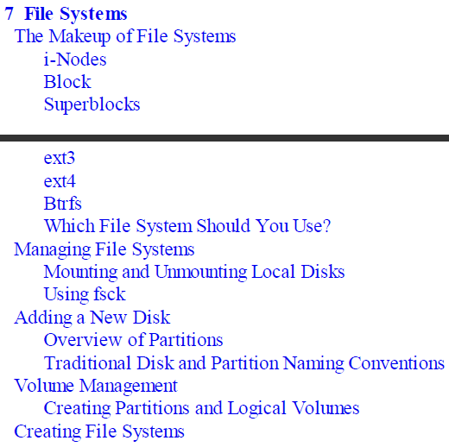
Content

Slide 3
Introduction
File systems provide a means of organizing data on a storage medium. They provide all of the abstraction layers above sectors and cylinders of disks. This chapter discusses the composition and management of these abstraction layers supported by Linux.
We’ll pay particular attention to the native Linux file systems—the extended file system family.
This chapter will also cover the many aspects of managing disks. This includes creating partitions and volumes, establishing file systems, automating the process by which they are mounted at boot time, and dealing with them after a system crash. It will also touch on Logical Volume Management (LVM) concepts.

Slide 4
The Makeup of File Systems
i-Nodes: An i-node is a control structure that points either to other i-nodes or to data blocks. The control information in the i-node includes the file’s owner, permissions, size, time of last access, creation time, group ID, and other information. This means each directory gets an i-node, and the i-node points to data blocks containing information (filenames and I nodes) [187].
Block: Depending on the block size, a block might contain only a part of a single file or an entire file. Blocks are in turn grouped into block groups. Among other things, the block group contains a copy of the superblock, the block group descriptor table, the block bitmap, an i-node table, and of course the actual data blocks [188].

Slide 5
Superblocks: The first piece of information read from a disk is its superblock. This small data structure reveals several key pieces of information, including the disk’s geometry, the amount of available space, and, most importantly, the location of the first i-node. Multiple copies of this data structure are scattered all over the disk to provide backup in case the first one is damaged.
Ext3:One of the benefits of using a journaling-type file system is the greater assurance that data integrity will be preserved, and in the unavoidable situations where problems arise, speed, ease of recovery run fsck.
Ext4:fourth extended file system (ext4) is the successor of ext3. It offers backward compatibility with ext3 and as such migrating or upgrading to ext4 is easy.
Extents: An extent is a way of representing contiguous physical blocks of storage on a file system. An extent provides information about the range or magnitude over which a data file extends on the physical storage.
Notes:
They offer significant improvements in performance and stability, but their most important component is that they have moved to a new method of getting the data to the disk. This new method is called journaling.

Slide 6
Btrfs
B-tree file system (Btrfs) is a next-generation Linux file system aimed at solving any enterprise scalability issues that the current Linux file systems may have.
Btrfs supports several additional features, including the following:
Dynamic i-node allocation
Online file system checking (fsck-ing)
Built-in RAID functions
Online defragmentation
Support for snapshots
Support for sub-volumes
Support for online addition and removal of block devices
Transparent compression
Improved storage utilization via support for data deduplication

Slide 7
Managing File Systems
Mounting and Unmounting Local Disks: Partitions need to be mounted so that their contents can be accessed. This helps to promote the illusion of one large directory tree structure, even though several different file systems might be in use. This characteristic is especially helpful to the administrator. forward slash character(/), kernel and core directory structure. Use mount command page 192.
Unmounting File Systems:To unmount a file system, use the umount command page 194.
Using fsck: used to diagnose and repair file systems that might have become damaged in the course of daily operations. Such repairs may be necessary after a system crash in which the system did not get a chance to fully flush all of its internal buffers to disk.

Slide 8
Adding a New Disk
system should automatically detect the new disk at boot time. All that remains is partitioning it and creating a file system on it.Run the dmesg command and see whether the driver loaded and was able to find your disk.
Overview of Partitions
Disks typically need to be partitioned before use. Partitions divide the disk into segments, and each segment acts as a complete disk by itself. Once a partition is filled with data, the data cannot automatically overflow onto another partition. Installing an OS into a single partition that spans the entire disk, installing several different OSs into their own separate partitions in what is commonly called a “dual-boot” configuration, and using the different partitions to separate and restrict certain system functions into their own work areas.
Hard disks start with the name sdX, where X can range from a through z, with each letter representing a physical block device. For example, in a system with two hard disks, the first hard disk would be /dev/sda and the second hard disk would be /dev/sdb.
When partitions are created, corresponding device files are created. They take the form of /dev/sdXY, where X is the device letter (as described in the preceding paragraph) and Y is the partition number.

Slide 9
Volume Management
This new approach to dealing with partitions is called Logical Volume Management (LVM) in Linux. It lends itself to several benefits and removes the restrictions, constraints, and limitations that the concept of partitions imposes.
Following are some of the benefits: Greater flexibility for disk partitioning, Easier online resizing of volumes, Easier to increase storage space by simply adding new disks to the storage pool,Use of snapshots.
important volume management terms (Physical volume (PV), Volume group (VG), Logical volume (LV), Extents)
Page 202,203

